Slide 1
STACKS AND QUEUES (Real-time case study)
– Ananth Kumar Vasamsetti

Slide 2


Definition:
Stack is a basic data structure that can be logically thought of as a linear structure represented by a real physical stack or pile. – wiki
Queue is a basic data structure that you can think of it as a line in a ticket counter. The first one in the line is the first one to be served. – wiki

Slide 3
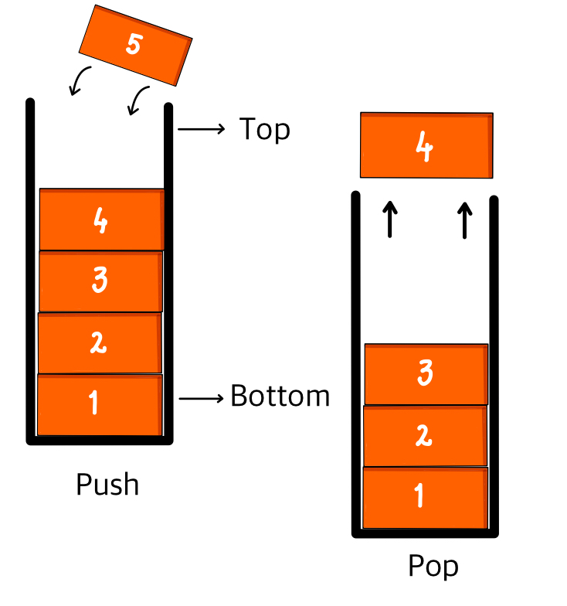
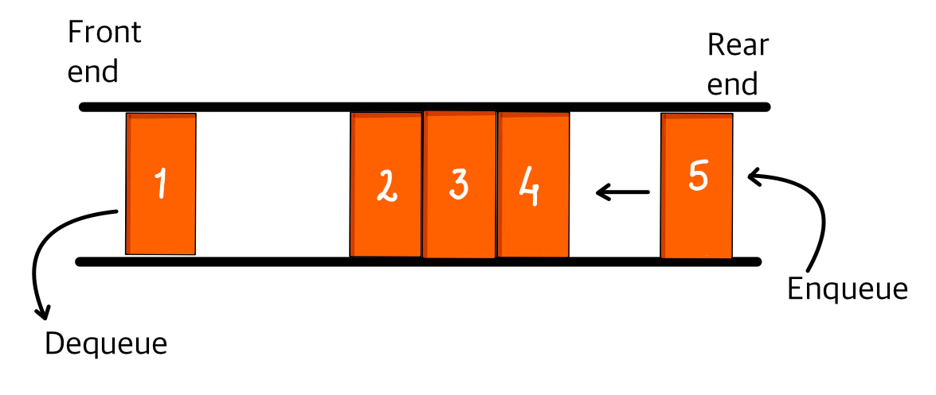
Differentiating factors:
Stacks – Last in first out (LIFO)
Queues – First in first out (FIFO)
Operation | Stack | Queue
Insert | Push | Enqueue
Remove | Pop | Dequeue

Slide 4
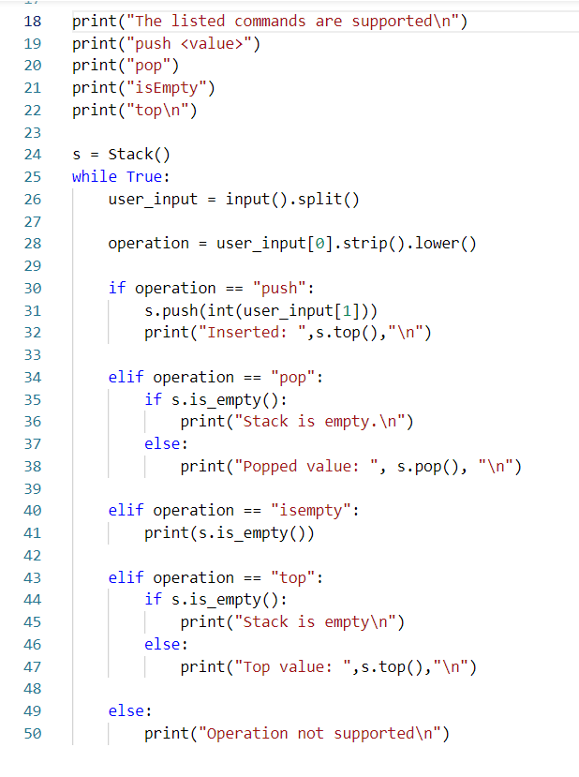
Operations(STACK):
push(<Element>): Inserts at the top of stack
pop(): Removes from the top of stack
size(): Returns the size of stack
isEmpty(): Returns Boolean indicating if stack is empty
top(): Returns the last inserted element (doesn’t removes it)

Slide 5
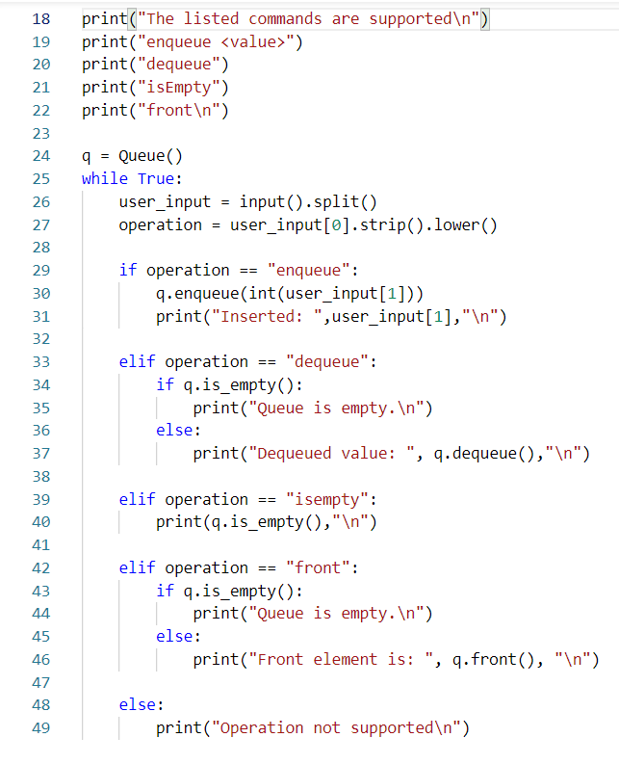
Operations(QUEUE):
enqueue(<Element>): Inserts at the rear end of queue
dequeue(): Removes from the front of queue
size(): Returns the size of queue
isEmpty(): Returns Boolean indicating if queue is empty
front(): Returns the element on the front (doesn’t removes it)

Slide 6
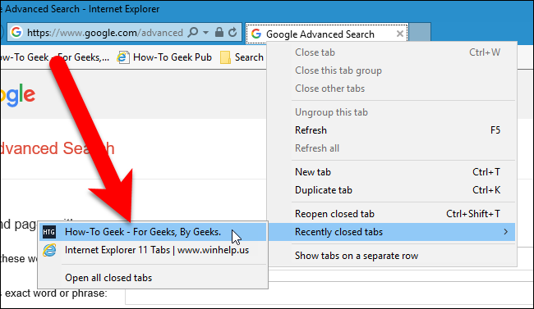
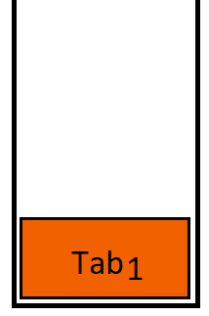
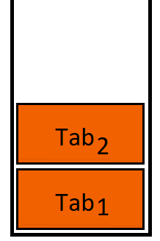
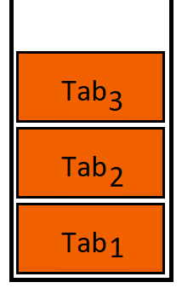
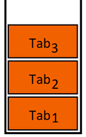
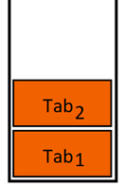

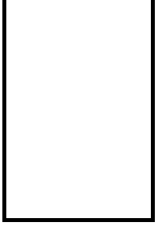
Realtime applications:
Recently closed tabs, is the everyday scenario we see which uses “Stacks” under the hood to keep track of the tabs that a user is dealing with.
Example:
User’s closing order of browser tabs Tab1, Tab2, Tab3
Closing order – left to right
Now, if one tries to reopen the tabs the one that was recently closed will be opened first and followed by the remaining. Hence the name Recently closed tabs.
Reopening order – left to right

Slide 7

Customer support call routing, these kind of systems use “Queues” while re-directing the calls to available support team members.
Which would be basically on first come first serve basis.
Example:
New incoming call
Executive 1
4 3 2 1
Executive 2
Service
Waiting to be served
Executive 3

Slide 8
References:
https://www.geeksforgeeks.org/stack-data-structure-introduction-program/
https://www.faceprep.in/data-structures/stack-applications-in-data-structure/
https://www.geeksforgeeks.org/queue-set-1introduction-and-array-implementation/
https://www.geeksforgeeks.org/applications-of-queue-data-structure/
Further reading https://en.wikipedia.org/wiki/Circular_buffer
Resources https://github.com/AnanthKumarVasamsetti/demo

